Slide 1
CSE 2215: Data Structure and Algorithms-I
Introduction, Divide and Conquer

Slide 2
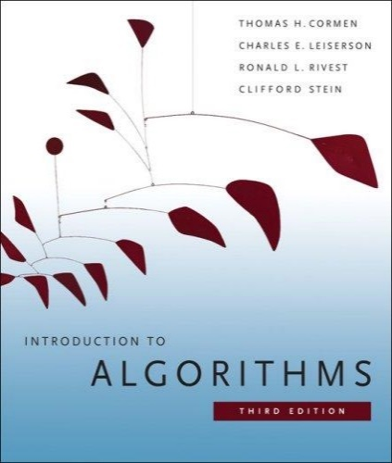
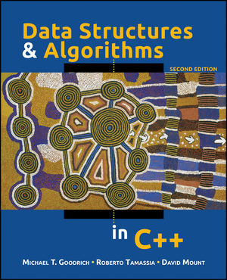
The Course
Text Books
Introduction to Algorithms (Third edition)
Cormen, Leiserson, Rivest, and Stein
An excellent reference you should own
Data Structures and Algorithms in C++
Goodrich, Tamassia, and Mount

Slide 3
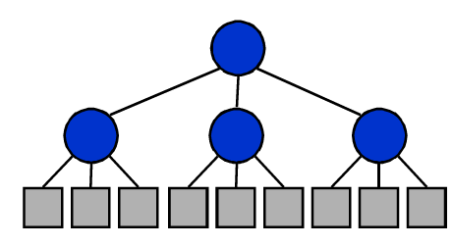
Divide and Conquer
Divide-and-Conquer is a general algorithm design paradigm:
Divide the problem into a number of subproblems that are smaller instances of the same problem
Conquer the subproblems by solving them recursively
Combine the solutions to the subproblems into the solution for the original problem
The base case for the recursion are subproblems of constant size
Analysis can be done using recurrence equations

Slide 4
Divide-and-Conquer
a problem of size n
subproblem 1
of size n/2
subproblem 2
of size n/2
Divide
a solution to
subproblem 1
a solution to
subproblem 2
a solution to
the original problem

Slide 5
MIN MAX PROBLEM

Slide 6
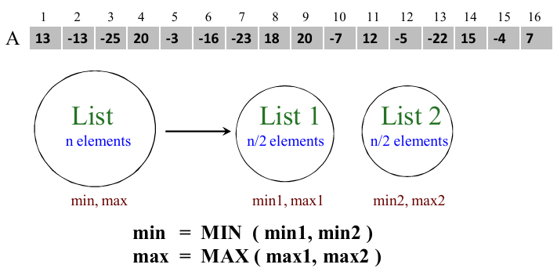
Finding Maximum and Minimum
Input: an array A[1..n] of n numbers
Output: the maximum and minimum value

Slide 7
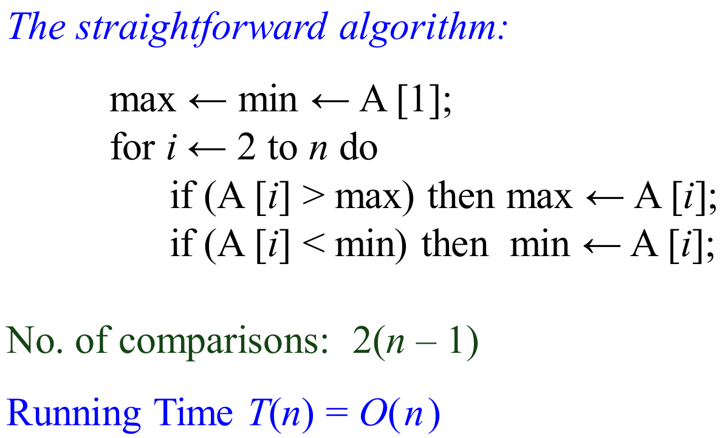
Finding Maximum and Minimum

Slide 8
Finding Maximum and Minimum
The Divide-and-Conquer algorithm:
Rmaxmin(i, j, fmax, fmin) {
if(i==j)
fmax ← A[i];
fmin ← A[i];
else
mid ← (i+j)/2;
Rmaxmin(i, mid, Lmax, Lmin);
Rmaxmin(mid+1, j, Rmax, Rmin);
fmax ← max(Lmax, Rmax);
fmin ← min(Lmin, Rmin);
}

Slide 9
Finding Maximum and Minimum
Index | 1 | 2 | 3 | 4 | 5 | 6 | 7 | 8 | 9
Array | 22 | 13 | -5 | -8 | 15 | 60 | 17 | 31 | 47
60,-8
MaxMin(1,9)
22,-8
60,17
MaxMin(1,5)
MaxMin(6,9)
22,-5
15,-8
Similar recursive
calls
MaxMin(1,3)
MaxMin(4,5)
22,13
-5,-5
MaxMin(1,2)
MaxMin(3,3)
-8,-8
15,15
MaxMin(4,4)
MaxMin(5,5)
22,22
13,13
MaxMin(1,1)
MaxMin(2,2)

Slide 10
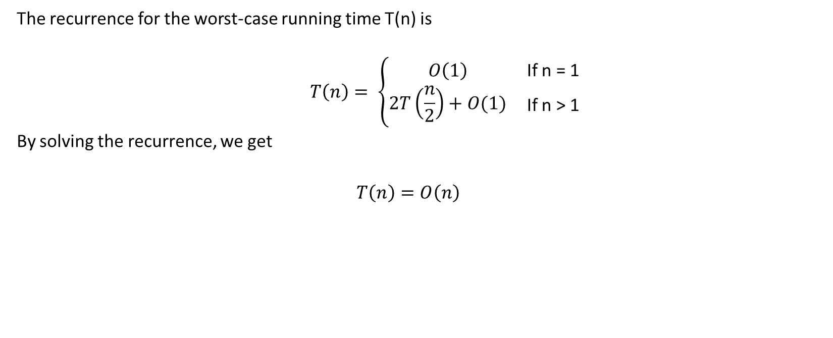
Time Complexity

Slide 11
Divide and Conquer
Problems we will cover:
Finding the Maximum Sub Array Problem
Finding the Maximum and Minimum
Merge Sort (Covered in DSA 1 - Revision)
Quick Sort (Covered in DSA 1 - Revision)
Others
We will also analyze the divide and conquer problems

Slide 12
MAXIMUM SUB ARRAY PROBLEM

Slide 13
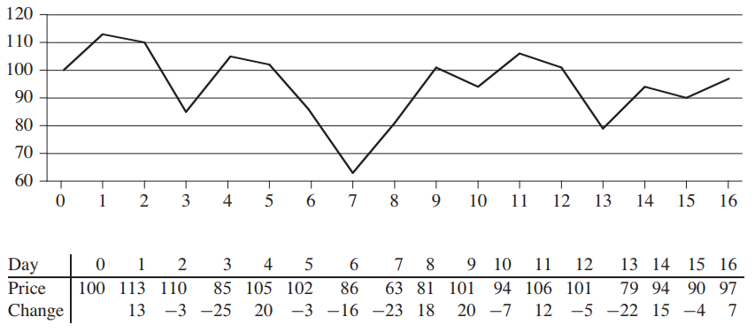
The Maximum Sub Array Problem
This is the prediction of prices of share of a company.
You want to buy the share on the day when the price is the lowest
You want to sell the share on the day when the price is the highest
Identify these two days

Slide 14
The Maximum Sub Array Problem
Buy on the 7th day and sell on the 11th day.
Total profit= 106-63=43
Also Total profit = 18+20-7+12=43

Slide 15
The Brute Force Approach
All possible contiguous subarrays
A[1..1], A[1..2], A[1..3], ..., A[1..(n-1)], A[1..n]
A[2..2], A[2..3], ..., A[2..(n-1)], A[2..n]
...
A[(n-1)..(n-1)], A[(n-1)..n]
A[n..n]
How many of them in total?
Algorithm: For each subarray, compute the sum.
Find the subarray that has the maximum sum.
O(n²)

Slide 16
Brute Force Approach
max = -∞
for i = 1 to n do
begin
sum = 0
for j = i to n do
begin
sum = sum + A[j]
if sum > max
then max = sum
end
end
Time complexity?
O(n²)

Slide 17
The Divide and Conquer Approach for Max Sub Array
Possible locations of a maximum subarray A[i..j] of A[low..high], where mid = ⎣(low + high)/2⎦
entirely in A[low..mid] (low ≤ i ≤ j ≤ mid)
entirely in A[mid+1..high] (mid < i ≤ j ≤ high)
crossing the midpoint (low ≤ i ≤ mid < j ≤ high)
crossing the midpoint
low mid high
mid +1
entirely in A[low..mid]
entirely in A[mid+1..high]
Possible locations of subarrays of A[low..high]

Slide 18
The Divide and Conquer Approach for Max Sub Array
-16 | -23 | 18 | 20 | -7 | 12 | -5
1 | 2 | 3 | 4 | 5 | 6 | 7
msa(A,1,7)
38(3,4)
43(3,6)
12(6,6)
msa(A,1,4)
msa(A,5,7)
15(2,4)
7(6,7)
-16(1,1)
38(3,4)
12(6,6)
5(7,7)
msa(A,1,2)
msa(A,3,4)
msa(A,5,6)
msa(A,7,7)
-39(1,2)
38(3,4)
-23(2,2)
18(3,3)
20(4,4)
-7(5,5)
12(6,6)
-16(1,1)
msa(A,1,1)
msa(A,2,2)
msa(A,3,3)
msa(A,4,4)
msa(A,5,5)
msa(A,6,6)

Slide 19
The Pseudocode

Slide 20
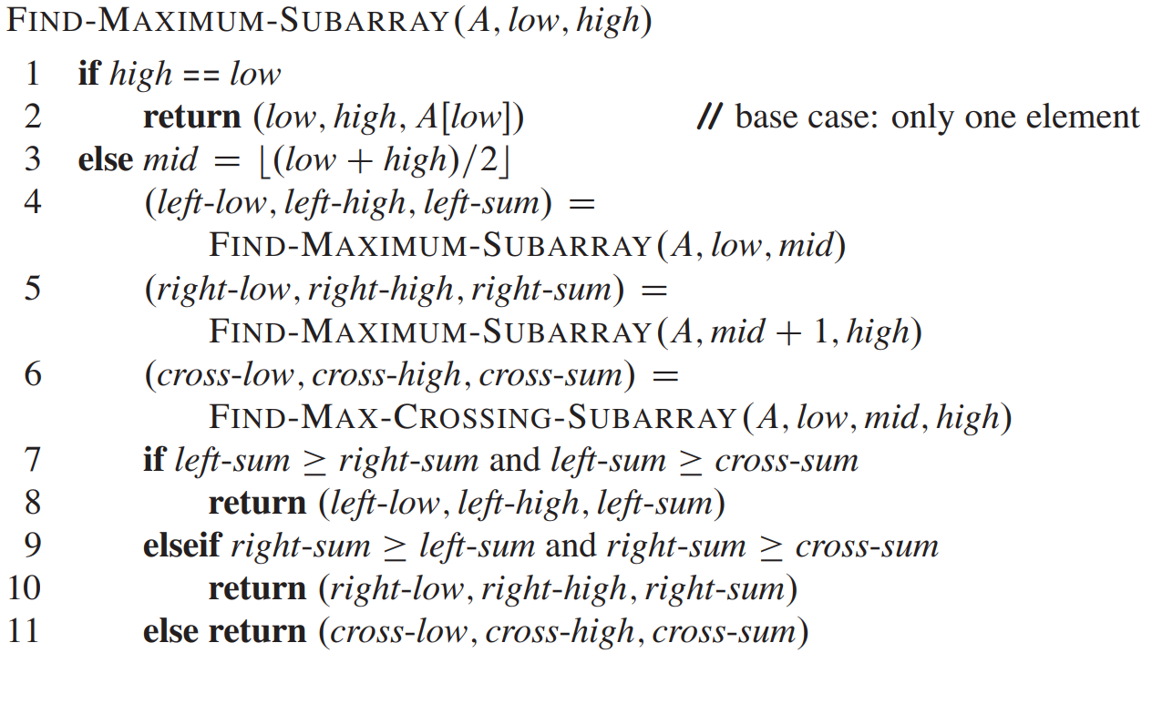
The Pseudocode

Slide 21
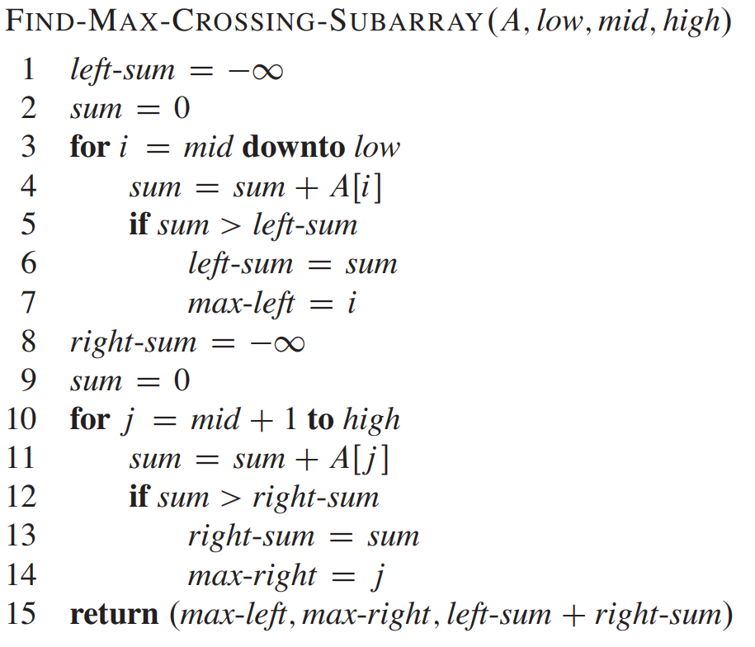
The Pseudocode

Slide 22
The Pseudocode
-16 | -23 | 18 | 20 | -7 | 12 | -5
1 | 2 | 3 | 4 | 5 | 6 | 7

Slide 23
The Pseudocode
leftSum=-inf
-16 | -23 | 18 | 20 | -7 | 12 | -5
1 | 2 | 3 | 4 | 5 | 6 | 7

Slide 24
The Pseudocode
leftSum=-inf
Sum =0
-16 | -23 | 18 | 20 | -7 | 12 | -5
1 | 2 | 3 | 4 | 5 | 6 | 7

Slide 25
The Pseudocode
leftSum=-inf
Sum =0
-16 | -23 | 18 | 20 | -7 | 12 | -5
1 | 2 | 3 | 4 | 5 | 6 | 7

Slide 26
The Pseudocode
leftSum=-inf
Sum =0
-16 | -23 | 18 | 20 | -7 | 12 | -5
1 | 2 | 3 | 4 | 5 | 6 | 7
i

Slide 27
The Pseudocode
leftSum=-inf
Sum =20
-16 | -23 | 18 | 20 | -7 | 12 | -5
1 | 2 | 3 | 4 | 5 | 6 | 7
i

Slide 28
The Pseudocode
leftSum=-inf
Sum =20
-16 | -23 | 18 | 20 | -7 | 12 | -5
1 | 2 | 3 | 4 | 5 | 6 | 7
i

Slide 29
The Pseudocode
leftSum=20
Sum =20
-16 | -23 | 18 | 20 | -7 | 12 | -5
1 | 2 | 3 | 4 | 5 | 6 | 7
i

Slide 30
The Pseudocode
leftSum=20
maxLeft=4
Sum =20
-16 | -23 | 18 | 20 | -7 | 12 | -5
1 | 2 | 3 | 4 | 5 | 6 | 7
i

Slide 31
The Pseudocode
leftSum=20
maxLeft=4
Sum =20
-16 | -23 | 18 | 20 | -7 | 12 | -5
1 | 2 | 3 | 4 | 5 | 6 | 7
i

Slide 32
The Pseudocode
leftSum=20
maxLeft=4
Sum =38
-16 | -23 | 18 | 20 | -7 | 12 | -5
1 | 2 | 3 | 4 | 5 | 6 | 7
i

Slide 33
The Pseudocode
leftSum=20
maxLeft=4
Sum =38
-16 | -23 | 18 | 20 | -7 | 12 | -5
1 | 2 | 3 | 4 | 5 | 6 | 7
i

Slide 34
The Pseudocode
leftSum=38
maxLeft=4
Sum =38
-16 | -23 | 18 | 20 | -7 | 12 | -5
1 | 2 | 3 | 4 | 5 | 6 | 7
i

Slide 35
The Pseudocode
leftSum=38
maxLeft=3
Sum =38
-16 | -23 | 18 | 20 | -7 | 12 | -5
1 | 2 | 3 | 4 | 5 | 6 | 7
i

Slide 36
The Pseudocode
leftSum=38
maxLeft=3
Sum =38
-16 | -23 | 18 | 20 | -7 | 12 | -5
1 | 2 | 3 | 4 | 5 | 6 | 7
i

Slide 37
The Pseudocode
leftSum=38
maxLeft=3
Sum =15
-16 | -23 | 18 | 20 | -7 | 12 | -5
1 | 2 | 3 | 4 | 5 | 6 | 7
i

Slide 38
The Pseudocode
leftSum=38
maxLeft=3
Sum =15
-16 | -23 | 18 | 20 | -7 | 12 | -5
1 | 2 | 3 | 4 | 5 | 6 | 7
i

Slide 39
The Pseudocode
leftSum=38
maxLeft=3
Sum =15
-16 | -23 | 18 | 20 | -7 | 12 | -5
1 | 2 | 3 | 4 | 5 | 6 | 7
i

Slide 40
The Pseudocode
leftSum=38
maxLeft=3
Sum =9
-16 | -23 | 18 | 20 | -7 | 12 | -5
1 | 2 | 3 | 4 | 5 | 6 | 7
i

Slide 41
The Pseudocode
leftSum=38
maxLeft=3
Sum =9
-16 | -23 | 18 | 20 | -7 | 12 | -5
1 | 2 | 3 | 4 | 5 | 6 | 7
i

Slide 42
The Pseudocode
leftSum=38
maxLeft=3
Sum =9
-16 | -23 | 18 | 20 | -7 | 12 | -5
1 | 2 | 3 | 4 | 5 | 6 | 7
i
Similarly the right sum is determined

Slide 43
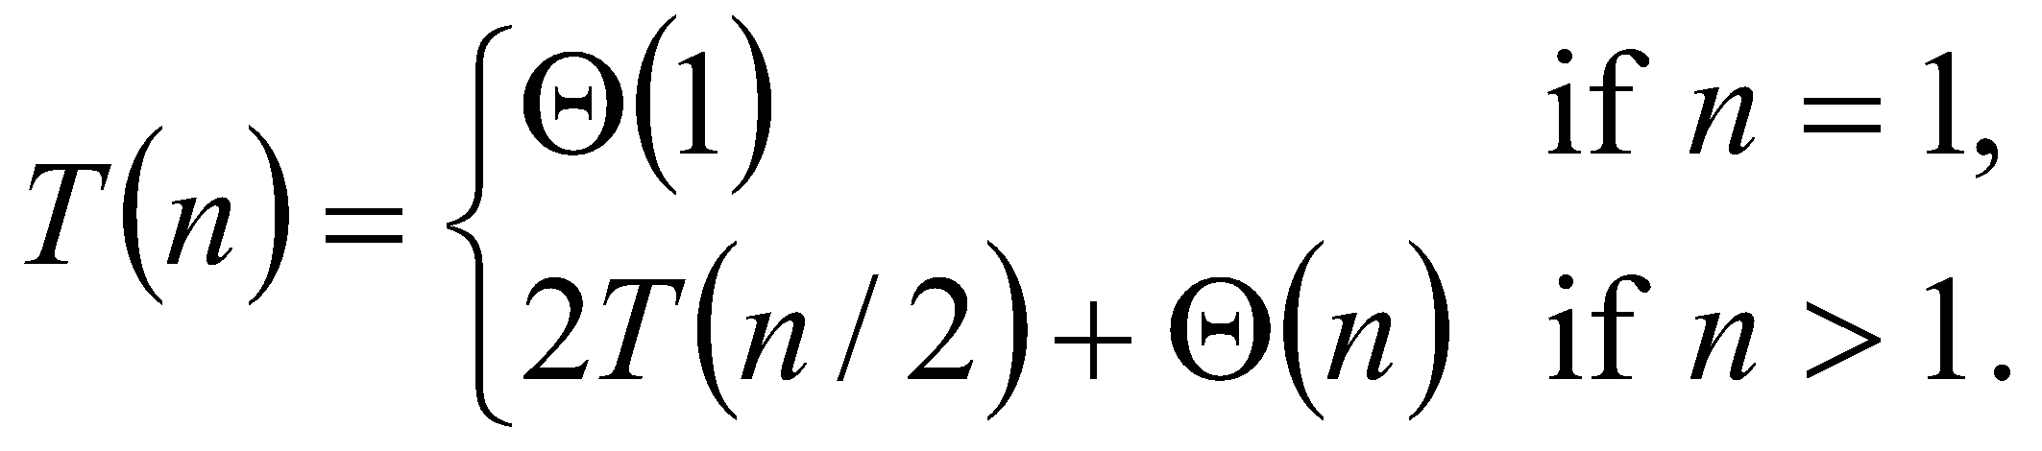
Time Complexity
FIND-MAX-CROSSING-SUBARRAY : Θ(n),
FIND-MAXIMUM-SUBARRAY
T(n) = 2T(n/2) + Θ(n)
= Θ(n lg n) (similar to merge-sort)

Slide 44
Time Complexity
We can determine the time complexity using:
The Iterative Approach
Recursive Tree
Master Theorem

Slide 45
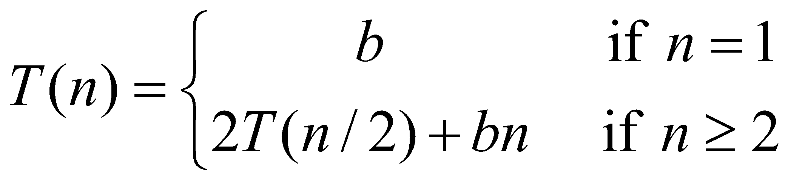
Time Complexity (Recursive Tree)
Draw the recursion tree for the recurrence relation and look for a pattern:
depth | T’s | size
0 | 1 | n
1 | 2 | n/2
… | … | …
i | 2^{i} | n/2^{i}
Time for max crossing sub array
bn
bn:(bn/2+bn/2)
bn:(bn/4+bn/4+bn/4+bn/4)
…
Total time = i * bn
i = log n.
T(n) = bnlog n +bn

Slide 46
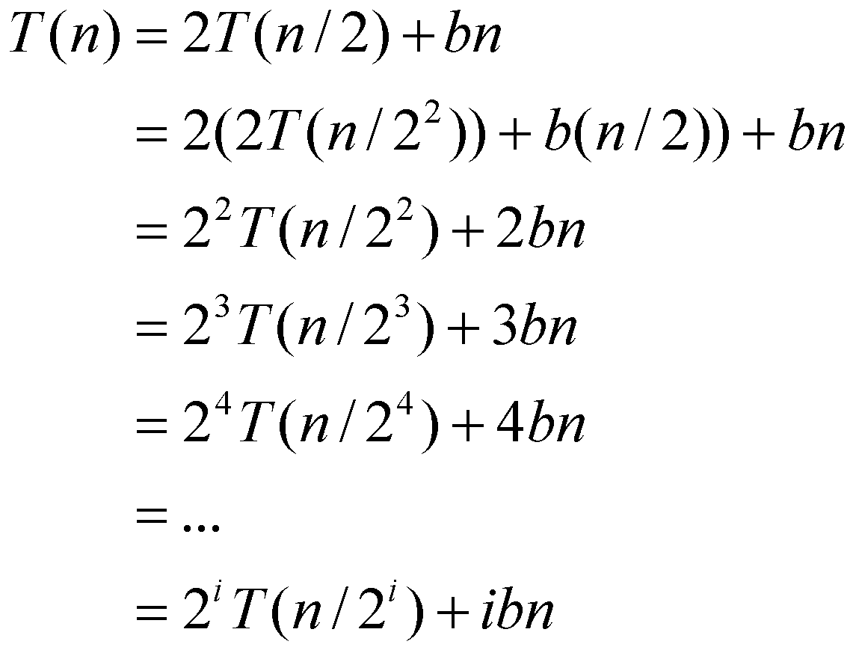
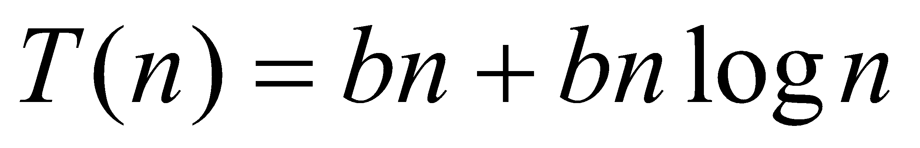
Time Complexity (Iterative Approach)
Note that base, T(n) =b, case occurs when 2^{i} = n.
That is, i = log n.
So,
Thus, T(n) is O(n log n).

Slide 47
COUNT EVEN NUMBERS

Slide 48
Count Even Numbers
Try the simulation yourself first
Determine time complexity

Slide 49
Similar Problems
You are given an array P [1..100], where an index is marked as 1 if it is a prime number or 0 if it is not a prime number (see the array below for reference). Determine the total number of prime numbers in a given array using a divide and conquer algorithm. Draw the recursive tree and write the pseudocode.
MergeSort (Done in DSA I – materials will be given in lms for revision)
QuickSort (Done in DSA I) (Done in DSA I – materials will be given in lms for revision)
1 | 2 | 3 | 4 | 5 | 6 | . | . | 99 | 100
0 | 1 | 1 | 0 | 1 | 0 |  |  | 0 | 0

Slide 50
Conclusion: Divide-and-Conquer
This Divide and conquer algorithm is clearly substantially faster than any of the brute-force methods. It required some cleverness, and the programming is a little more complicated – but the payoff is large.
Divide and conquer is just one of several powerful techniques for algorithm design
Divide-and-conquer algorithms can be analyzed using recurrences
Can lead to more efficient algorithms

Slide 51
Thank You

